Slide 1
Overview of Apache Kafka
DO NOT WRITE ANYTHING
HERE. LEAVE THIS SPACE FOR
WEBCAM

Slide 2
Web
Server
App
Server
Chat
Server
Media
Server
Spark
Streaming
Security
System
Visualization Tool

Slide 3
Web
Server
App
Server
Chat
Server
Media
Server
Producers
Kafka Cluster
Spark
Streaming
Security
System
Visualization Tool
Consumers

Slide 4
Agenda
What is Kafka?
Understand the need of Kafka
Learn Kafka Architecture
Describe Kafka Workflow
Configure Kafka Cluster
Perform Basic Topic Operations
Understand Performance Tuning in Kafka
Learn Applications of Kafka
Integrate Apache Flume with Apache Kafka
DO NOT WRITE ANYTHING
HERE. LEAVE THIS SPACE FOR
WEBCAM

Slide 5
What is Kafka?
Apache Kafka is an open-source, distributed, and publish-subscribe messaging system that maintains and manages a stream of real-time data from different applications, websites, different databases, etc.
In 2011, Apache Kafka became an open sourced Apache project, and in 2012, it was made a first-class Apache project.
Scala and Java are the languages used by Kafka.
Kafka delivers high performance, scalability, durability, fault tolerance, and a distributed computing experience by design.
Streaming applications and real-time pipelines can be built using Kafka.
DO NOT WRITE ANYTHING
HERE. LEAVE THIS SPACE FOR
WEBCAM

Slide 6
Need for Kafka
Industry today is becoming more and more dependent on real-time data that must be processed in real time. For Example:
Data from sensors that can be used to predict a system failure in advance.
Economic data that is based on preliminary estimates and is frequently updated for better estimates.
Organizations can host websites or applications on multiple servers, like Web and Application Servers, at the front and back ends.
As a result, we will need multiple data pipelines to connect all of these servers to the database servers.
Organizations can host websites or applications on multiple servers, like Web and Application Servers, at the front and back ends
DO NOT WRITE ANYTHING
HERE. LEAVE THIS SPACE FOR
WEBCAM
Notes:
Source- created internally

Slide 7
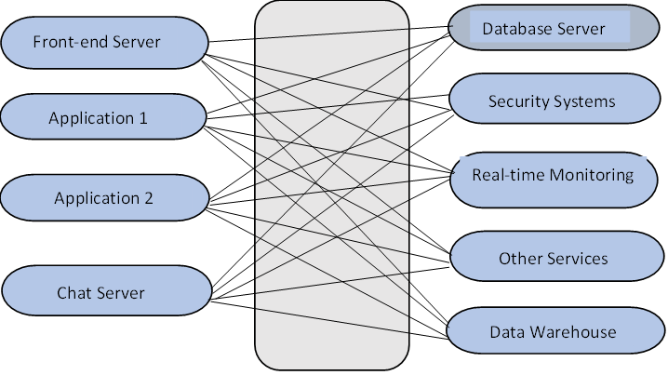
Need for Kafka
With the increase in the number of systems, it is evident that data pipelines are becoming more complex.
Data flow will be more complicated with the addition of a new system or server.
Since these data pipelines have different requirements, managing them becomes extremely challenging. In such cases, it is hard to add or remove pipelines.
DO NOT WRITE ANYTHING
HERE. LEAVE THIS SPACE FOR
WEBCAM
Notes:
Source – created internally

Slide 8
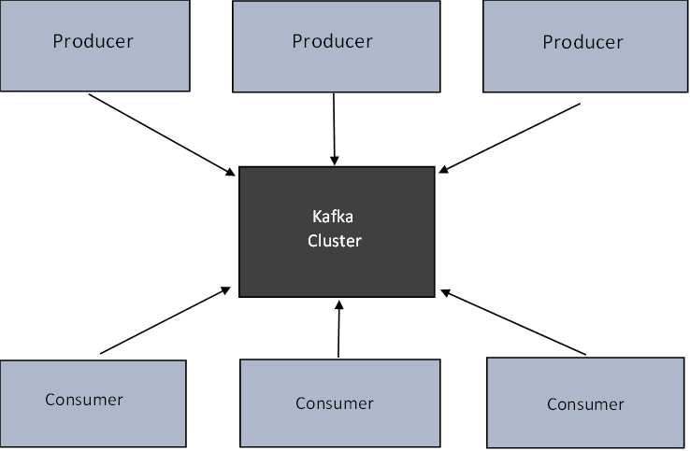
Kafka Decouples Data Pipelines
Kafka allows the communication between systems to be simplified and manageable by decoupling data pipelines between systems.
Apache Kafka reduces the complexity of data pipelines.
Kafka is useful for establishing asynchronous communication and sending messages.
DO NOT WRITE ANYTHING
HERE. LEAVE THIS SPACE FOR
WEBCAM
Notes:
Source – created internally

Slide 9
Web Server
Chat Server
DATA
ABCDEFGH
Broker-0
Broker-1
Broker-2
Broker-3
ADG
BEH
CFI
CFI
ADG
BEH
Spark
Topic: Web
Partitions = 3
Replication = 2

Slide 10
Web Server
Web Server
Chat Server
DATA
ABCDEFGH
DATA
ZZZXXXYYY
Broker-0
Broker-1
Broker-2
Broker-3
ABCDEF
ZZZXXXYYY
Topic: Web
Topic: Chat
Security System
Spark

Slide 11
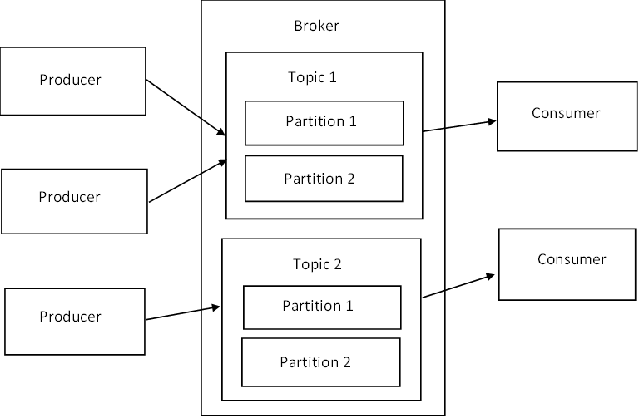
Kafka Components
DO NOT WRITE ANYTHING
HERE. LEAVE THIS SPACE FOR
WEBCAM
Notes:
Source – created internally

Slide 12
Kafka Components
Broker: Brokers are servers that manage and mediate the conversation between two different systems and ensure that appropriate messages are delivered to the right parties.
Message: Messages are simply byte arrays, and developers can store any object in any format they choose. These formats include String, JSON, Avro, and many more.
Topic: In Kafka, all messages are maintained in topics. And these topics hold, publish, and organize messages.
Cluster: Apache Kafka clusters are made up of multiple brokers, i.e., a set of servers. Also, it consists of multiple computers, each of which has one Kafka broker.
DO NOT WRITE ANYTHING
HERE. LEAVE THIS SPACE FOR
WEBCAM

Slide 13
Kafka Components
Producers: In Kafka, producers publish data or messages to one or more topics. They are basically what generate data streams.
Consumers: Kafka consumers are processes that consume topics in the cluster and read and process the data.
Partitions: For every partition on the broker, there can either be a leader or a replica. All 'writes' and 'reads' go through the leader, and if the leader fails, the replica takes over.
DO NOT WRITE ANYTHING
HERE. LEAVE THIS SPACE FOR
WEBCAM

Slide 14
Kafka Architecture
Broker 1
Consumer
Topic -1
Partition-0
Producer
Broker 2
Consumer
Topic – 1
Partition -1
Producer
Broker 3
Topic -1
Partition -2
Consumer
Zookeeper
DO NOT WRITE ANYTHING
HERE. LEAVE THIS SPACE FOR
WEBCAM
Kafka Cluster
Notes:
Source – created internally

Slide 15
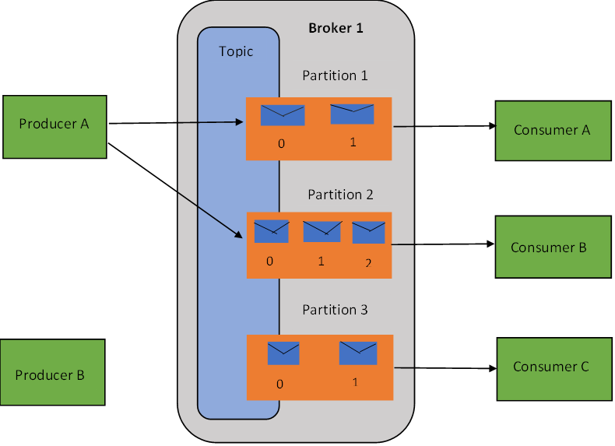
Kafka Architecture: Inside View
DO NOT WRITE ANYTHING
HERE. LEAVE THIS SPACE FOR
WEBCAM
Notes:
Source – created internally

Slide 16
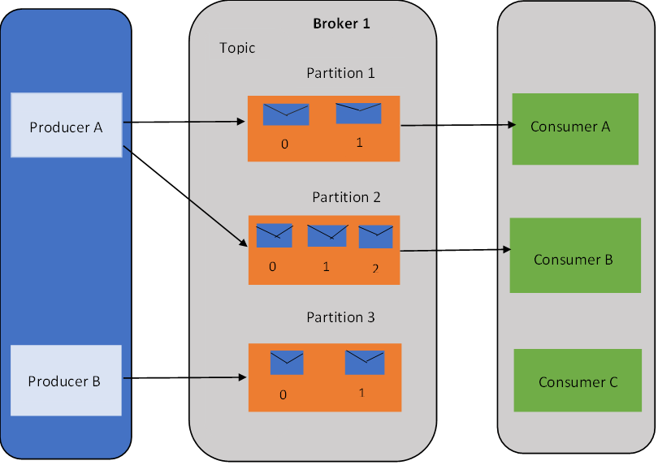
Kafka Producer
A producer sends a message (also known as a record) to a topic.
The producer selects the partitions per topic in which to send the messages.
Depending on the priority of individual records, producers can send them to certain partitions. According to the record's key, producers send records to a partition.
The producer sends the messages as fast as the broker can handle and does not depend on the broker’s acknowledgement.
DO NOT WRITE ANYTHING
HERE. LEAVE THIS SPACE FOR
WEBCAM
Notes:
Source- created internally

Slide 17
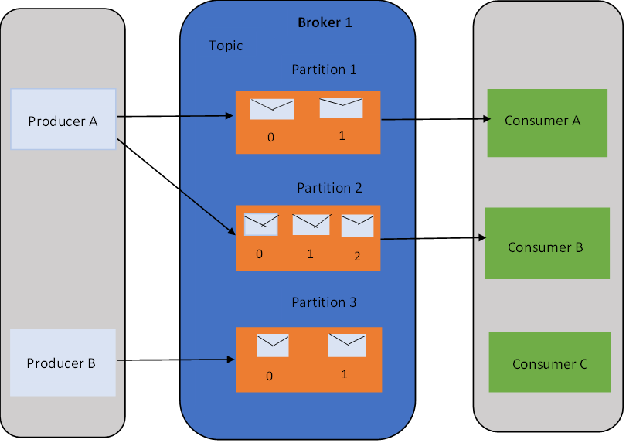
Kafka Broker
In a cluster, there are numerous brokers which are used to maintain load balance.
Upon receiving messages from the producer, a broker assigns offsets to them and commits the messages to disk for storage.
For instance, a broker can process thousands of reads and writes per second and TB of messages.
There are multiple brokers that have a backup of topic partitions. In the case of a broker failure, the broker holding the backup partitions would become the leader.
DO NOT WRITE ANYTHING
HERE. LEAVE THIS SPACE FOR
WEBCAM
Notes:
Source- created internally

Slide 18
DO NOT WRITE ANYTHING
HERE. LEAVE THIS SPACE FOR
WEBCAM
Notes:
Source- created internally

Slide 19
Kafka Topics and Partitions
Topics are assigned to messages in Kafka. And topics are divided into several partitions.
It only accepts append-only messages.
Reading messages can be done either in order from beginning to end or by specifying an offset value for skipping or rewinding to any point in the partition.
The offset value provides the sequential ID for all the messages.
Redundancy and scalability are provided by partitions.
A single topic can be scaled horizontally across multiple servers by hosting a partition on each server, this improves the performance.
DO NOT WRITE ANYTHING
HERE. LEAVE THIS SPACE FOR
WEBCAM

Slide 20
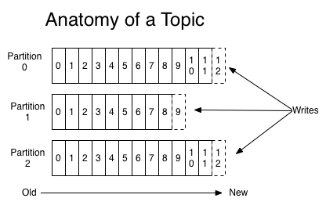
Kafka Topics & Partitions
The figure represents the topic with 3 partitions, and the message written is being appended in every partition.
If the record key is present, records are stored in the partition by record key. If the record key is absent, records are stored by round-robin.
DO NOT WRITE ANYTHING
HERE. LEAVE THIS SPACE FOR
WEBCAM
Notes:
Source-https://kafka.apache.org/081/documentation.html

Slide 21
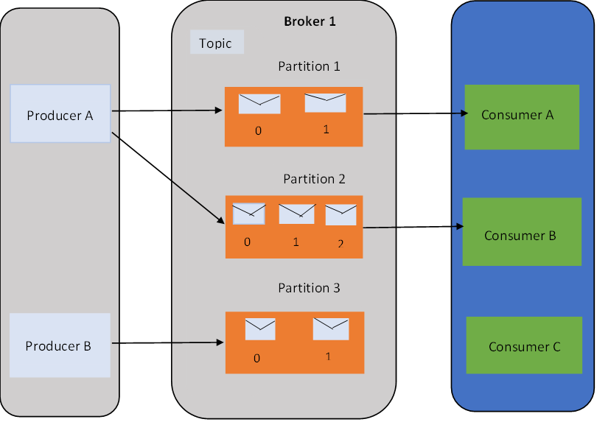
Kafka Consumer
It is possible to subscribe to one or more topics so that the consumer can read the messages in the order they were produced.
When a consumer consumes messages, it keeps track of the offset of messages already consumed.
Each consumer works together as part of a consumer group to consume a topic.
A message with the same key is received by the same consumer.
Each member of the group consumes only one partition at a time.
DO NOT WRITE ANYTHING
HERE. LEAVE THIS SPACE FOR
WEBCAM
Notes:
Source- created internally

Slide 22
Apache Zookeeper
ZooKeeper is Apache’s open-source project that provides users with centralized infrastructure and services that enable synchronization across Apache Hadoop clusters.
Originally developed at Yahoo, ZooKeeper supports synchronization by maintaining status on ZooKeeper servers which store information in local log files.
Apache Zookeeper servers also support large Hadoop clusters.
DO NOT WRITE ANYTHING
HERE. LEAVE THIS SPACE FOR
WEBCAM

Slide 23
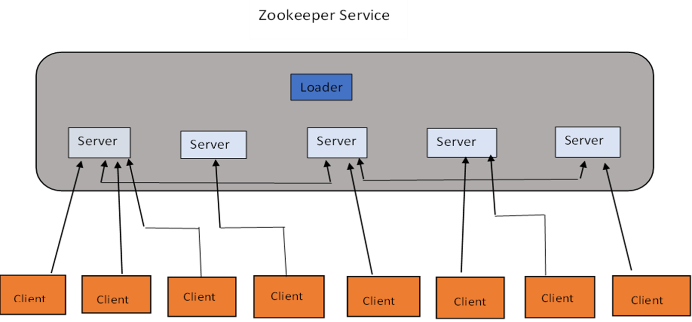
Zookeeper Architecture
DO NOT WRITE ANYTHING
HERE. LEAVE THIS SPACE FOR
WEBCAM
Notes:
Source- created internally

Slide 24
ZooKeeper Architecture
This technology consists of the following components:
Apache ZooKeeper Basics | Work Performed
Server Applications | Provide a common interface for interaction with client applications
Client Applications | A set of tools for communicating with distributed applications
ZooKeeper Nodes | Clusters run on these systems
Znode | Any node can update or modify the information
DO NOT WRITE ANYTHING
HERE. LEAVE THIS SPACE FOR
WEBCAM
Notes:
Source- created internally

Slide 25
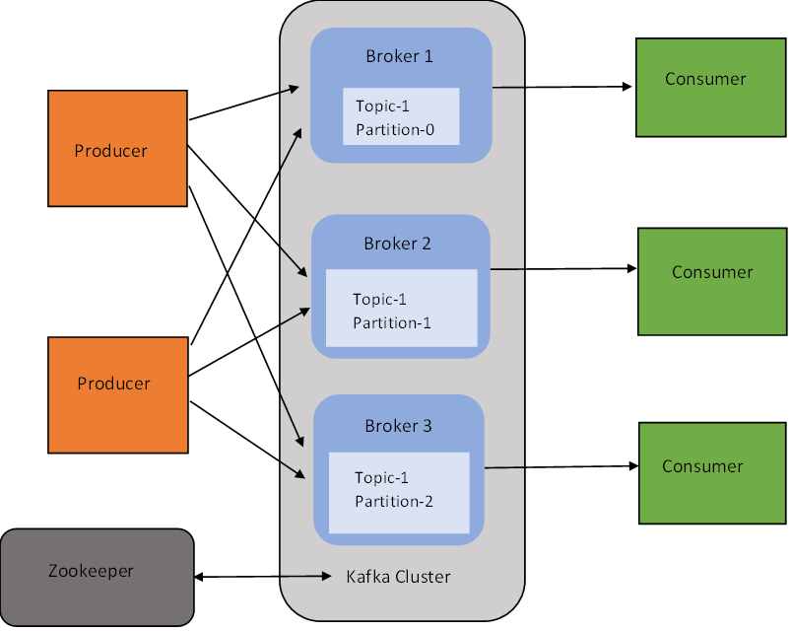
ZooKeeper & Kafka
ZooKeeper is used by Kafka brokers to coordinate with one another.
ZooKeeper is designed to notify producers and consumers when new brokers are added to the system or when brokers fail.
Apache ZooKeeper will appoint a new leader based on the currently active nodes if the current leader fails.
DO NOT WRITE ANYTHING
HERE. LEAVE THIS SPACE FOR
WEBCAM
Notes:
Source- created internally

Slide 26
Kafka Workflow
Workflow of Pub/Sub Messaging
Messages will be sent regularly to a topic by producers.
Messages are stored by brokers in partitions that are configured for a particular topic.
Kafka stores one message from a producer in the first partition and the second message from the producer in the second partition if there are two partitions.
Consumers always subscribe to a specific topic.
Kafka provides the current offset for the topic to the consumer when the consumer subscribes to the topic, and this offset is stored within the ZooKeeper ensemble.
Kafka will be queried regularly by the consumer for new messages (like every 100 ms).
DO NOT WRITE ANYTHING
HERE. LEAVE THIS SPACE FOR
WEBCAM

Slide 27
Workflow of Pub/Sub Messaging
A message is forwarded to consumers immediately after it has been received from the producer.
Consumers will process the message once they receive it.
After a message has been processed, it is acknowledged by the broker.
When the acknowledgement is received, the offset is updated in the ZooKeeper with the new value.
ZooKeeper maintains offsets so that consumers can continue to read the new messages even during server outages.
As long as the consumer does not stop the request, the flow repeats.
DO NOT WRITE ANYTHING
HERE. LEAVE THIS SPACE FOR
WEBCAM

Slide 28
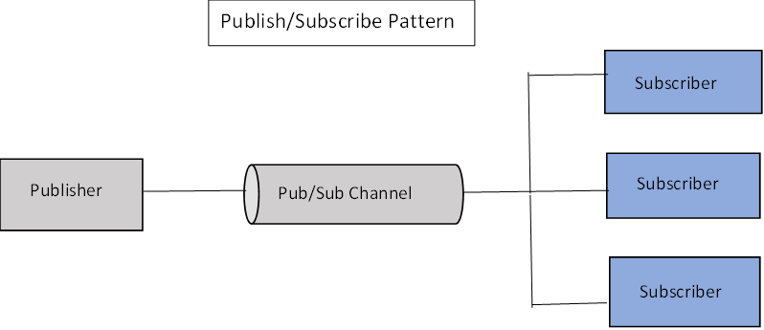
Workflow of Pub/Sub Messaging
DO NOT WRITE ANYTHING
HERE. LEAVE THIS SPACE FOR
WEBCAM
Notes:
Source- created internally

Slide 29
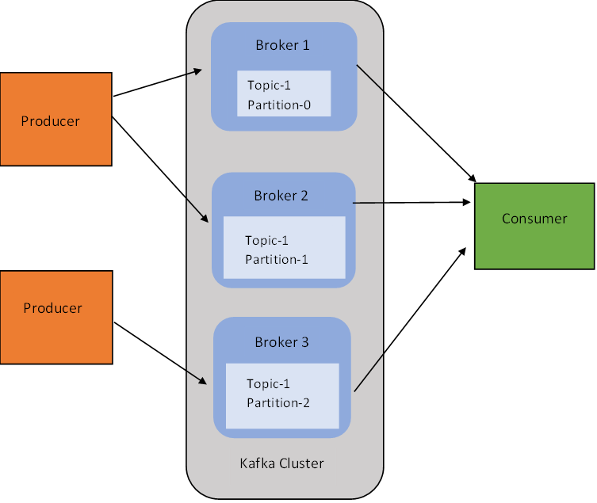
Kafka Cluster
Local development works best with one Kafka server.
A cluster of multiple brokers provides significant benefits.
One of the biggest benefits is scalability as multiple servers can handle the load.
In order to maintain the Kafka cluster or underlying systems' performance, replications are used.
Kafka is an effective tool when it comes to processing large volumes of messages.
DO NOT WRITE ANYTHING
HERE. LEAVE THIS SPACE FOR
WEBCAM

Slide 30
Kafka Command Line Tools
The following broker setups can be used by the Kafka cluster:
Single broker cluster
Multiple broker cluster
Kafka Shell Script | Description
zookeeper-server-start.sh | ZooKeeper is started by using the properties in config/zookeeper.properties
kafka-server-start.sh | config/server.properties is used to start the Kafka server
kafka-topics.sh | You can use it to create topics and list them
kafka-console-producer.sh | Messages can be sent via a command line client to the Kafka cluster
kafka-console-consumer.sh | The Kafka cluster client is a command line program for consuming messages
DO NOT WRITE ANYTHING
HERE. LEAVE THIS SPACE FOR
WEBCAM

Slide 31
Types of Kafka Cluster
Single Node- Single Broker Cluster
Zookeeper
Producer
Consumer
Single Node-Single Kafka Broker
Producer
Consumer
Producer
Consumer
DO NOT WRITE ANYTHING
HERE. LEAVE THIS SPACE FOR
WEBCAM

Slide 32
Types of Kafka Cluster
Zookeeper
Single Node- Multiple Broker Cluster
Single Node-Single Kafka Broker
Consumer
Producer
Producer
Broker 1
Consumer
Producer
Consumer
Broker 2
DO NOT WRITE ANYTHING
HERE. LEAVE THIS SPACE FOR
WEBCAM
Broker 3

Slide 33
Kafka Cluster Types
Zookeeper
Node 1
Consumer
Broker 1
Producer
Consumer
Broker 2
Producer
Consumer
Multiple Nodes-Multiple Broker Cluster
Node 2
Producer
Broker 1
DO NOT WRITE ANYTHING
HERE. LEAVE THIS SPACE FOR
WEBCAM
Broker 2

Slide 34
Kafka Performance Tuning
Two important metrics are involved in tuning performance:
Latency: The processing time for one event
Throughput: Within a given period of time, how many events occur
For both cases, Apache Kafka is optimized.
If a Kafka system has just enough brokers to process both topic throughput and the latency needed for information to be processed in real-time, then it is tuned well.
For Kafka clusters, there is the best balance between throughput and latency by:
Tuning producers, Tuning brokers, and Tuning consumers to send, process, and receive the largest batch sizes within a manageable period of time.
DO NOT WRITE ANYTHING
HERE. LEAVE THIS SPACE FOR
WEBCAM

Slide 35
Tuning Broker
As already discussed:
There are several partitions for each topic
Also, every partition has a leader.
The following are standard configurations for reliability:
The topic will include two or more follower partitions as well as a leader partition
When leaders are not properly balanced, one partition may be overworked compared to others.
Maintain a sufficient number of replication sets for data preservation
Generally, it is advised to start with a single partition per physical storage disk and a single consumer per partition.
DO NOT WRITE ANYTHING
HERE. LEAVE THIS SPACE FOR
WEBCAM

Slide 36
Tuning Producer
The batch size and the linger time are the two most important parameters for latency and throughput.
Batch Size:
batch.size is used to measure the batch size in total bytes.
It determines the size of the data to gather before sending messages to the broker.
This value should be as high as possible without exceeding the available memory.
16384 is the default value.
Linger time:
Data in asynchronous mode can be buffered for a maximum time with linger.ms
Example:A setting of 100 will batch 100ms of messages together.
While this increases throughput, it adds latency to message delivery.
DO NOT WRITE ANYTHING
HERE. LEAVE THIS SPACE FOR
WEBCAM

Slide 37
Tuning Consumer
A consumer group can contain as many consumers as there are partitions on a topic.
You will need a sufficient number of partitions to handle all consumers needed to keep up with all producers.
The partitions are split among consumers in the same consumer group.
The performance of a group can be improved by adding more consumers.
Performance is not affected by adding consumer groups.
DO NOT WRITE ANYTHING
HERE. LEAVE THIS SPACE FOR
WEBCAM

Slide 38
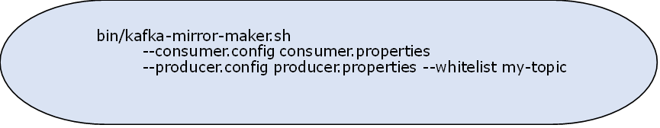
Mirroring Data between Kafka Clusters
Mirroring between two Kafka clusters is achieved using this tool.
Throughput is increased by mirroring.
In order to achieve greater fault tolerance, in-cluster replication is recommended.
Example: Mirroring a single topic (named my-topic) from an input cluster.
DO NOT WRITE ANYTHING
HERE. LEAVE THIS SPACE FOR
WEBCAM

Slide 39
Apache Kafka Applications
Storm-Kafka is an integral part of Twitter's stream processing infrastructure.
Kafka is used by Netflix to monitor events in real-time and process them.
LinkedIn uses it to track activity streams and operational metrics.
Using its Enterprise Service Bus product called OSB (Oracle Service Bus), Oracle provides native connectivity to Kafka.
DO NOT WRITE ANYTHING
HERE. LEAVE THIS SPACE FOR
WEBCAM

Slide 40
Summary
The Apache Kafka system allows you to build real-time streaming data pipelines, and it has applications for adapting a huge volume of data streams.
Kafka clusters are capable of handling failures of masters and databases.
Even when storing TBs of messages, it maintains stable performance.
This allows for the storage and analysis of both historical and real-time data since it combines messaging, storage, and stream processing.
DO NOT WRITE ANYTHING
HERE. LEAVE THIS SPACE FOR
WEBCAM

Slide 41
Thank You
DO NOT WRITE ANYTHING
HERE. LEAVE THIS SPACE FOR
WEBCAM

